Slide 1

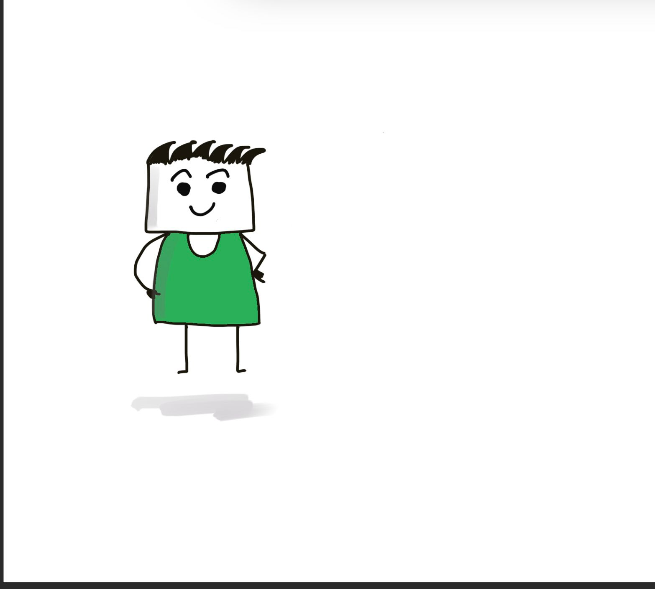
Iti Tyagi
Full Stack Developer (That’s my alter ego on the right in green.)

Slide 2
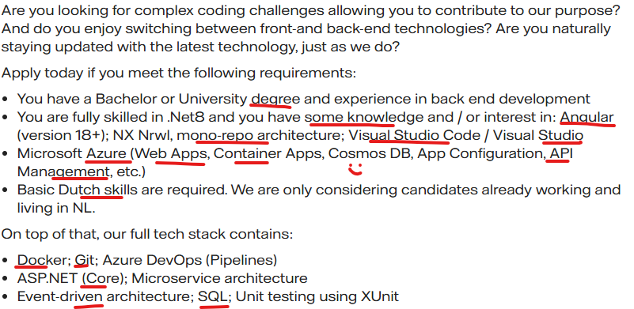
Job Description

Slide 3
Rocket Game

Slide 4
But there is more..

Slide 5
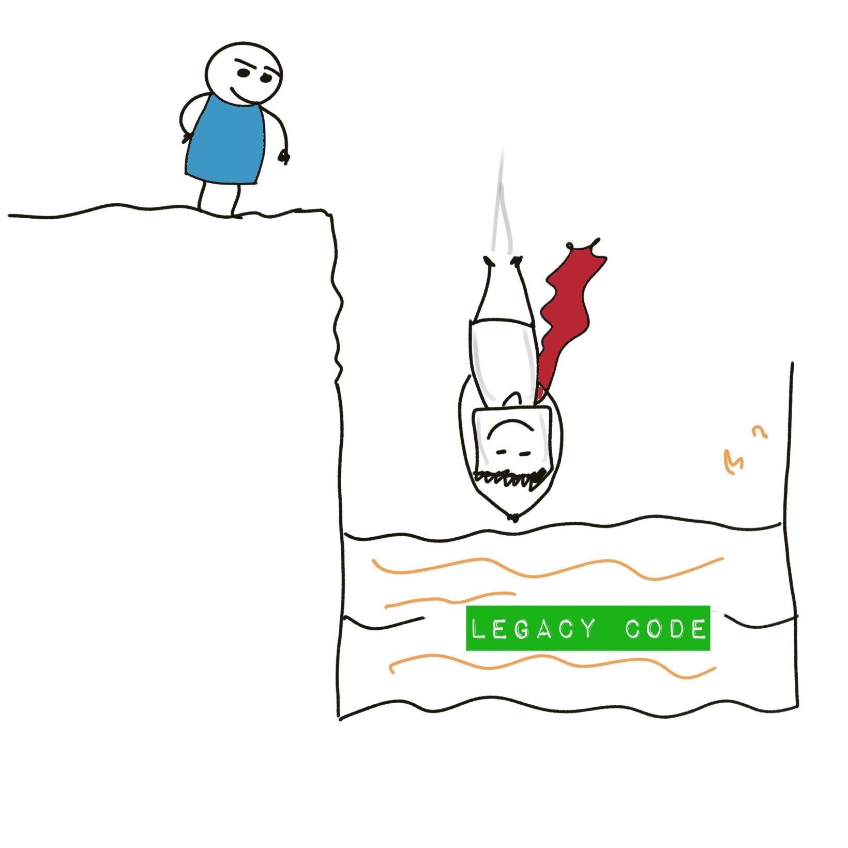
Jumping into Legacy Code

Slide 6
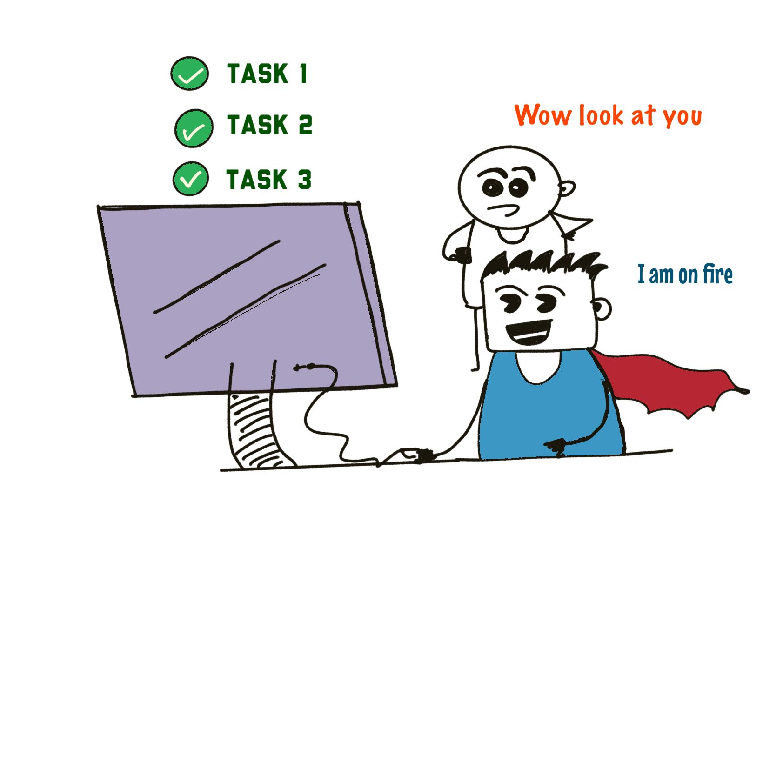
Reliable

Slide 7
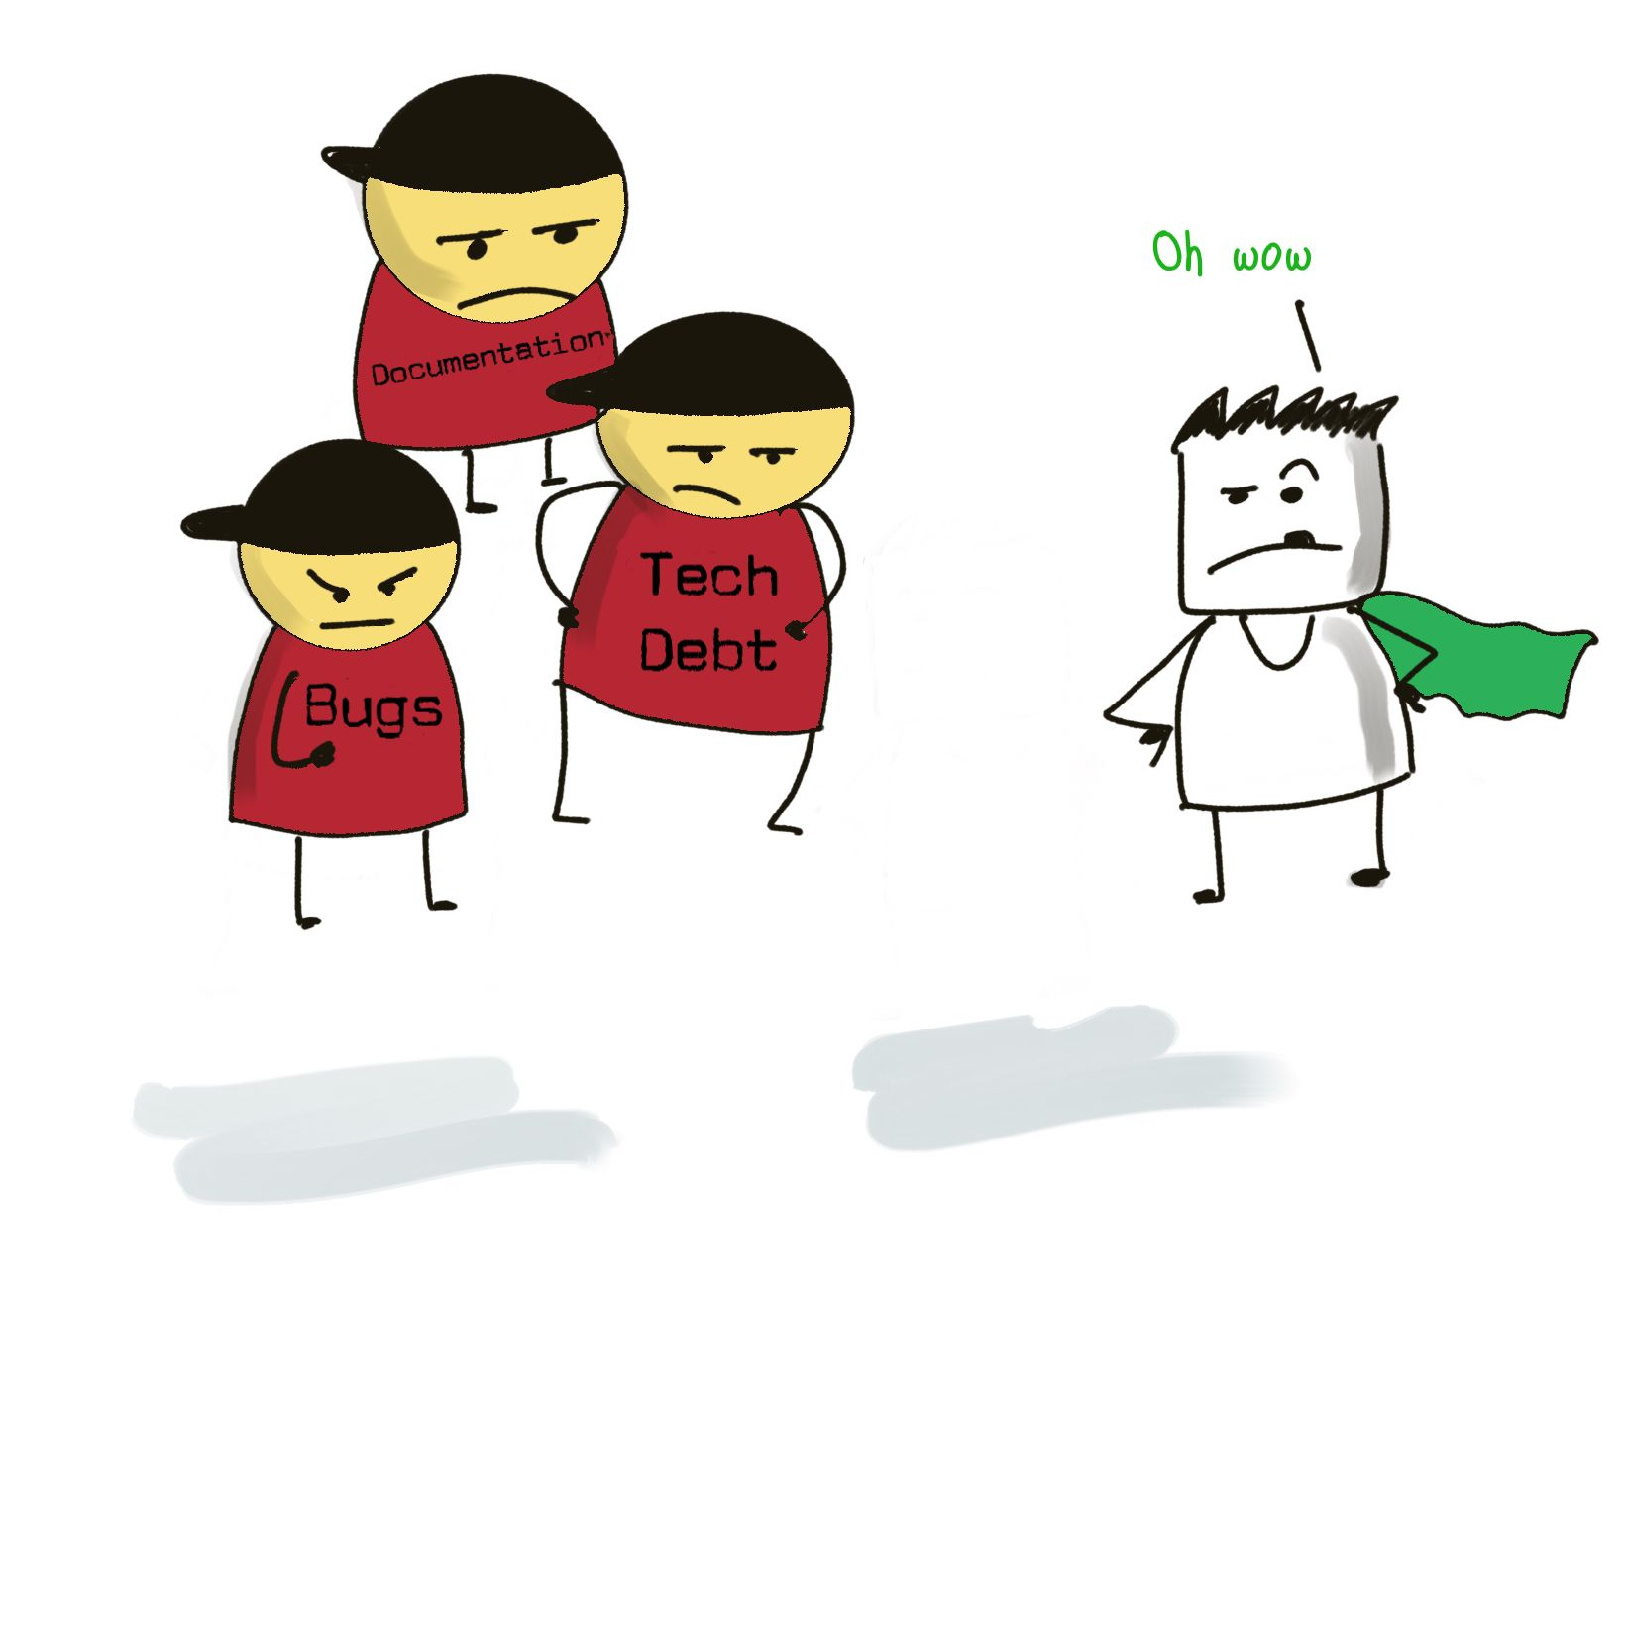
Multiple Domain Experience

Slide 8
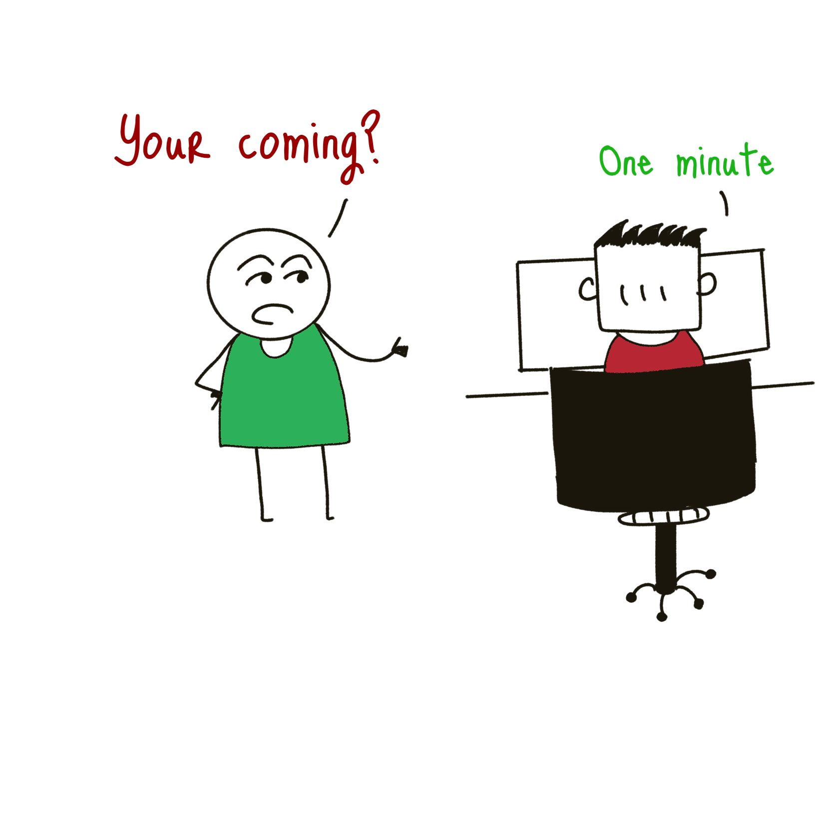
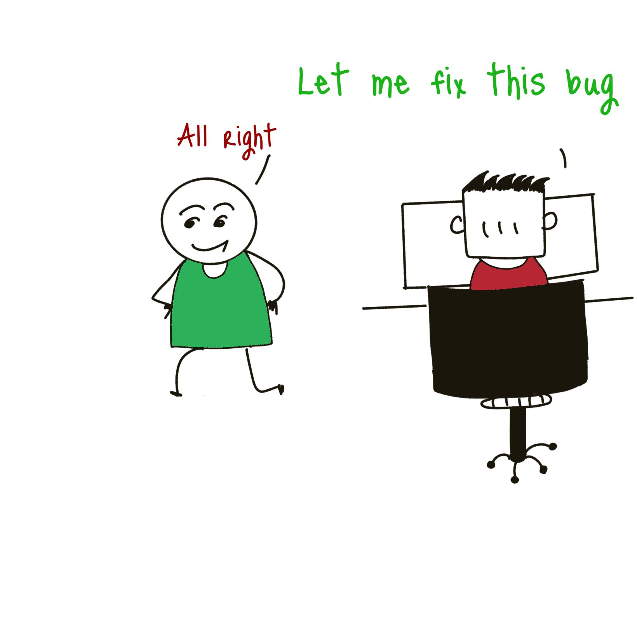
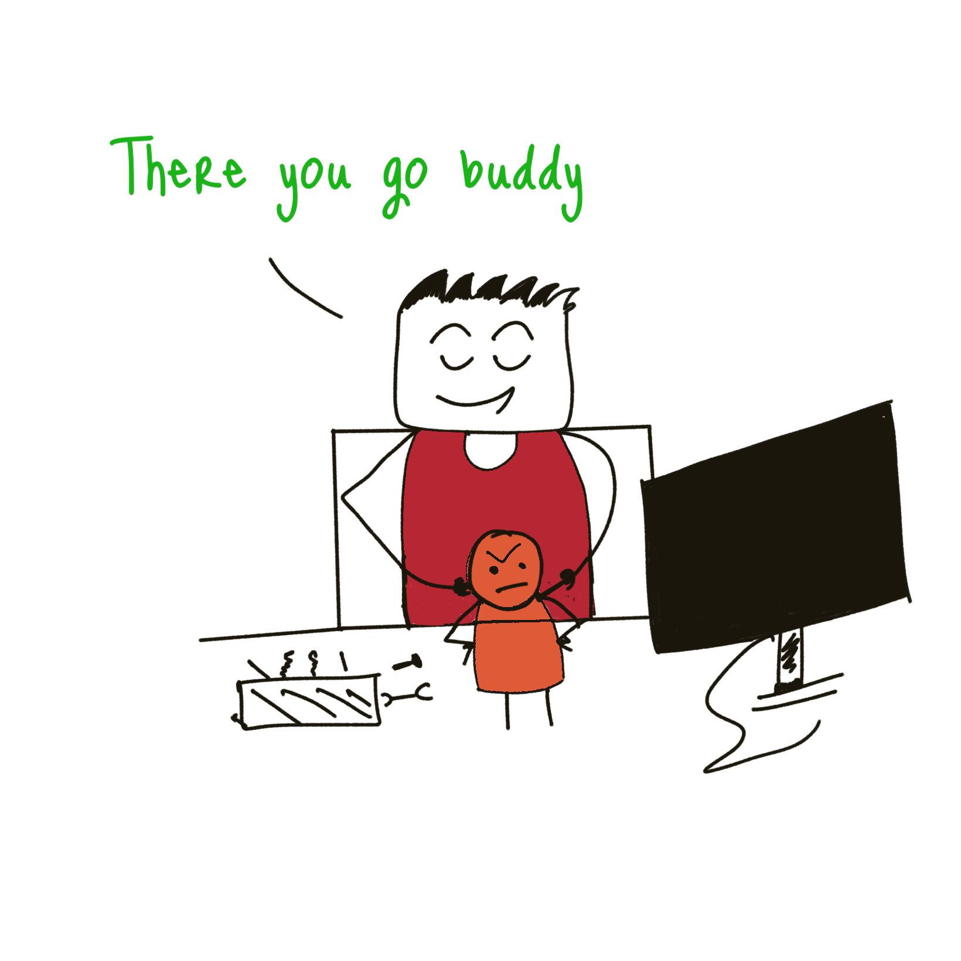
Good debugger

Slide 9

Spider Focus (Thread it all..)

Slide 10
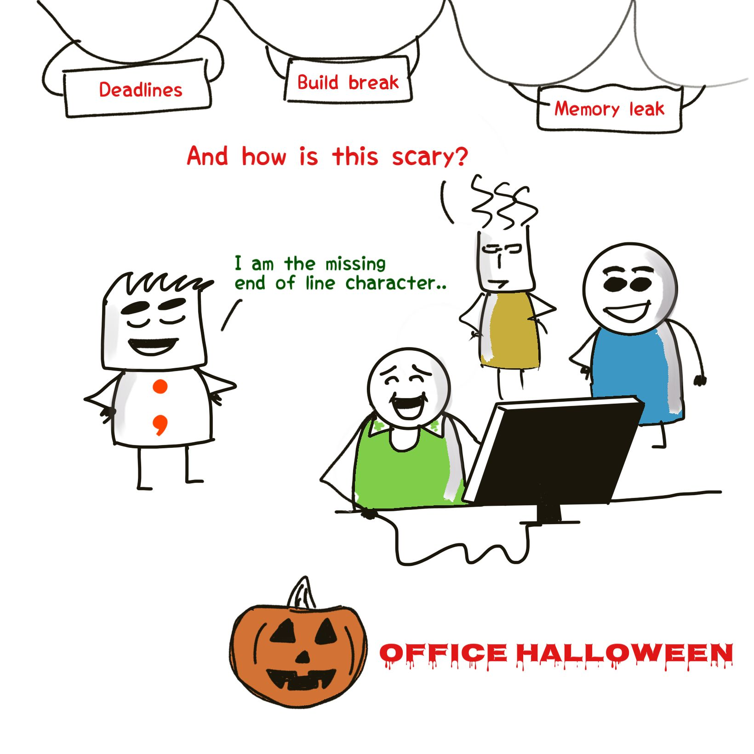
Try try try till you find the missing link (in my case an employer who can recognize my unique talent for problem solving, without dreading)

Slide 11
Monologue…
Hi, I am your basic, 100th time rejected applicant. You will check my resume, will look at what I worked on, oh its not a match and throw away (may be send me a default rejection email). No worries, one of the zillionth rejections in my pocket. Yesterday I gave a logical reasoning tests, got 72% at Bunq, but they and multiple other startups/established companies rejected me. In 2018, I scored 43%, I was still called and asked to justify it, well long story short, I became the Senior Programmer for Volkswagen Electric car. An average brain fog interview candidate, solves issues in Camera Tiles, major bugs for Audi e-tron. I am not the smartest, But I am the one they come to when nothing works. You tell me a problem, and have some faith, well we are half-way through solution anyway. As I say 1+1 is not 2, its 11 :)

Slide 12
Background
I started in a very small startup where I worked for ~16 hours, but later transitioned into bigger firm (process and tickets..)
Moved to Financial firms like Morgan Stanley (C#, .NET) to Gartner Inc. (Java, PHP, MySQL, DS.JS..) to City Bank (.NET, R, Quant Modelling, Statistics) to Healthcare (C#, Azure, SQL, React JS) to Automotive (C++, Linux, Cmake, CI/CD ..) and there is more… I cherish writing simple code, understandable code, not solving the number of problems, but solving them right. Writing thoughtful design, collaboration and helping whole team to grow together. Clean Code, avoiding Technical debts. Great Designs are thoughtful, efficient and practical.

Slide 13

Thankyou

